Slide 1
Intro to R 2023
Day 2

Slide 2
What we will cover
Data visualisation in ggplot2
Setting up your own project
Managing it with git and github
Other file types
Excel, NASA Ames, NetCDF
Writing your own functions
Other ways of running R

Slide 3
Data Vis

Slide 4
Other slide deck

Slide 5
Projects

Slide 6
Setting up your own Project
Projects are a feature of RStudio and help compartmentalise your work
Launching RStudio from a project file automatically sets your working directory to that location
Helps keep your data, scripts and plots together

Slide 7

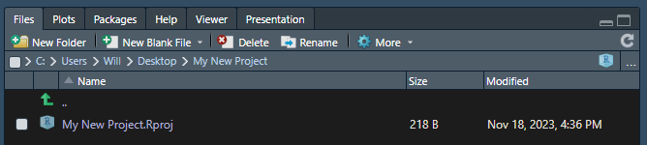
Setting up your own Project
New Project –
New Directory -> New project
If you already have a folder that isn’t a project, you can click existing directory
Fill in the details and create project

Slide 8
Setting up your own Project
I like to add “data”, “scripts”, “plots” as my main folders
If I am going to be making presentations in R, I’ll probably also include a “presentation” folder
Use file paths relative to the project directory
Your default working directory is set here if you launch from the project
You can always find your data, even if you change computers
The here package
Forces paths to default to the project directory
Adapts paths for different operating systems
Even works in Quarto/RMarkdown (which defaults to paths relative to the .Rmd file!)

Slide 9
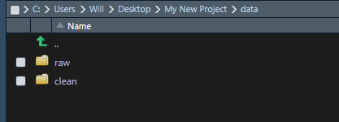

Thinking about Project Structure
Best practise is that *ALL* things you do to and with your data are described in code.
This differs to workflows in excel
imagine making a change to a cell, then sending the file to someone else, they have no idea what has changed.
Doing this in R
You send them the raw data and your script, the changes are clearly laid out in the code, and they can reproduce your steps exactly
Almost certainly your raw data is not tidy, and comes from multiple sources. Write a script to clean it and save the output in a subdirectory

Slide 10
How big is your data?
Is it sensible to keep a copy of your data within your project directory?
For smaller datasets this is 100% desirable – it makes it very difficult to lose your data.
Data sets up to 100s of mb can probably be kept like this
Having duplicates of this for different projects is probably not going to fill up your HDD anytime soon
e.g. a few air quality monitoring sites, small campaign data, a few FAAM Flights
Avoid syncing the data folder to github with .gitignore
Larger data – e.g. model outputs, meteorology fields, big databases
One copy for multiple projects or stored on some shared storage.
Use a configuration file that is stored within your project and defines where the raw data is stored
Provide some documentation of an example configuration so others can make their own.

Slide 11
Perfect is the enemy of the good
Did you download the data from a website?
You could write code to download it
This is fine if its simple: e.g the Oxford Government Response Tracker dataset
It's just a link to a .csv, so we can use `download.file()`
path = "https://github.com/OxCGRT/covid-policy-dataset/raw/main/data/OxCGRT_compact_national_v1.csv" download.file(path, here::here('data','raw','oxgrt.csv'))
Is it more complicated, like a webform?
Option 1 – learn webscraping* and still write code
Pros: Actually really fun, your project is *even* more reproducible
Cons: A pain in the arse, can take a really long time, Will will want to talk to you about it.
Option 2 – Document in your code comments where you got it from and move on.
*if you are interested, checkout the `rvest` and `httr` packages

Slide 12
The effort is usually worth it
Take the air quality monitoring site example
You do your analysis on 2 sites, then at the end realise you have missed a 3rd important one (or 2 -> 30, or 300 etc)
If your analysis is manual, time to get to work
If you’ve got a reproducible project, it might be as simple as changing 1 line of code

Slide 13
Track changes with Git

Slide 14
Common File Formats

Slide 15
Excel
If you can‘t avoid it, use the `readxl` package

Slide 16
Plain Text
Other delimiters with read.table()
Skipping headers – useful for NASA Ames
More complex plain texts include the the Sift outputs!
Fortunately someone has written code to do this: https://github.com/wacl-york/siftr

Slide 17
NetCDF
Binary file, so you can’t inspect with notepad etc.
Metadata is hard coded alongside variables
Just as Excel has multiple “sheets”, netCDFs can have multiple “grids”
Core FAAM data uses them to store different time resolution data
Variables are split into two categories
Independent variables are dimensions, e.g. time, lat, lon, alt
Dependant variables are variables and change with dimensions
Both have attributes like units
Can optionally define “transformations”
e.g. you can define time as 1, 2, 3, etc then have a “transform” for 2, 4, 32 Hz to get the time for different acquisition rates.
`Tidync` and `ncmeta` OR `ncdf4`
Use a FAAM file as an example

